Slide 1
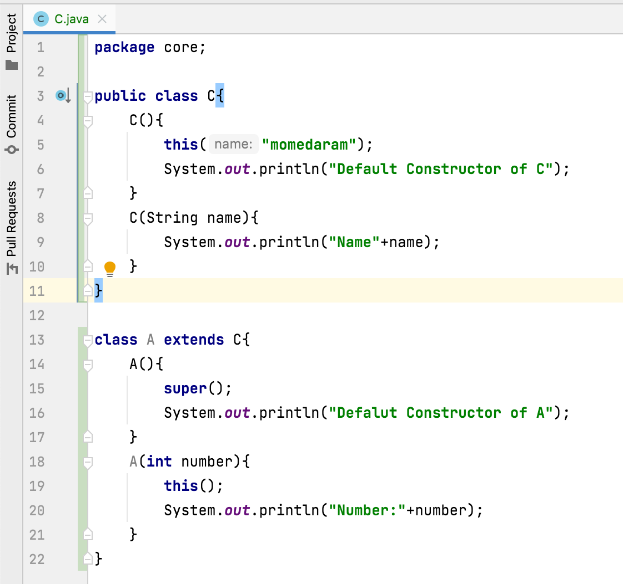
Can we call sub class constructor from a super class constructor?
No. There is no way in Java to call sub class constructor from a super class constructor.
super() - from subclass to super class
this() – to current class

